Slide 1

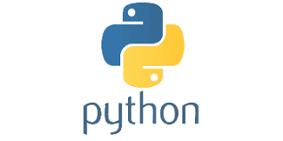
PYTHON
Lecture 1

Slide 2

Today’s Agenda
An Introduction to Python
Necessity Of Programming
What Is Python ?
Why And Who Created It ?
What Python Can Do ?
Why Should I Learn Python In 2019 ?
Important Features

Slide 3
Why Do We Need Programming ?
To communicate with digital machines and make them work accordingly
Today in the programming world , we have more than 800 languages available.
And every language is designed to fulfill a particular kind of requirement

Slide 4
Brief History Of Prog. Lang
C language was primarily designed to develop “System Softwares” like Operating Systems, Device Drivers etc .
To remove security problems with “C” language , C++ language was designed.
It is an Object Oriented Language which provides data security and can be used to solve real world problems.
Many popular softwares like Adobe Acrobat , Winamp Media Player,Internet Explorer,Mozilla Firefox etc were designed in C++
Courtsey:http://www.stroustrup.com/applications.html

Slide 5
What is Python ?
Python is a general purpose and powerful programming language.
Python is considered as one of the most versatile programming language as it can be used to develop almost any kind of application including desktop application , web applications , mobile application , network programming , image processing and many more.

Slide 6
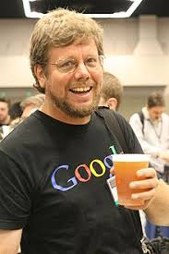
Who created Python ?
Developed by Guido van Rossum , a Dutch scientist
Created at Center For Mathematics and Research , Netherland
It is inspired by another programming language called ABC

Slide 7
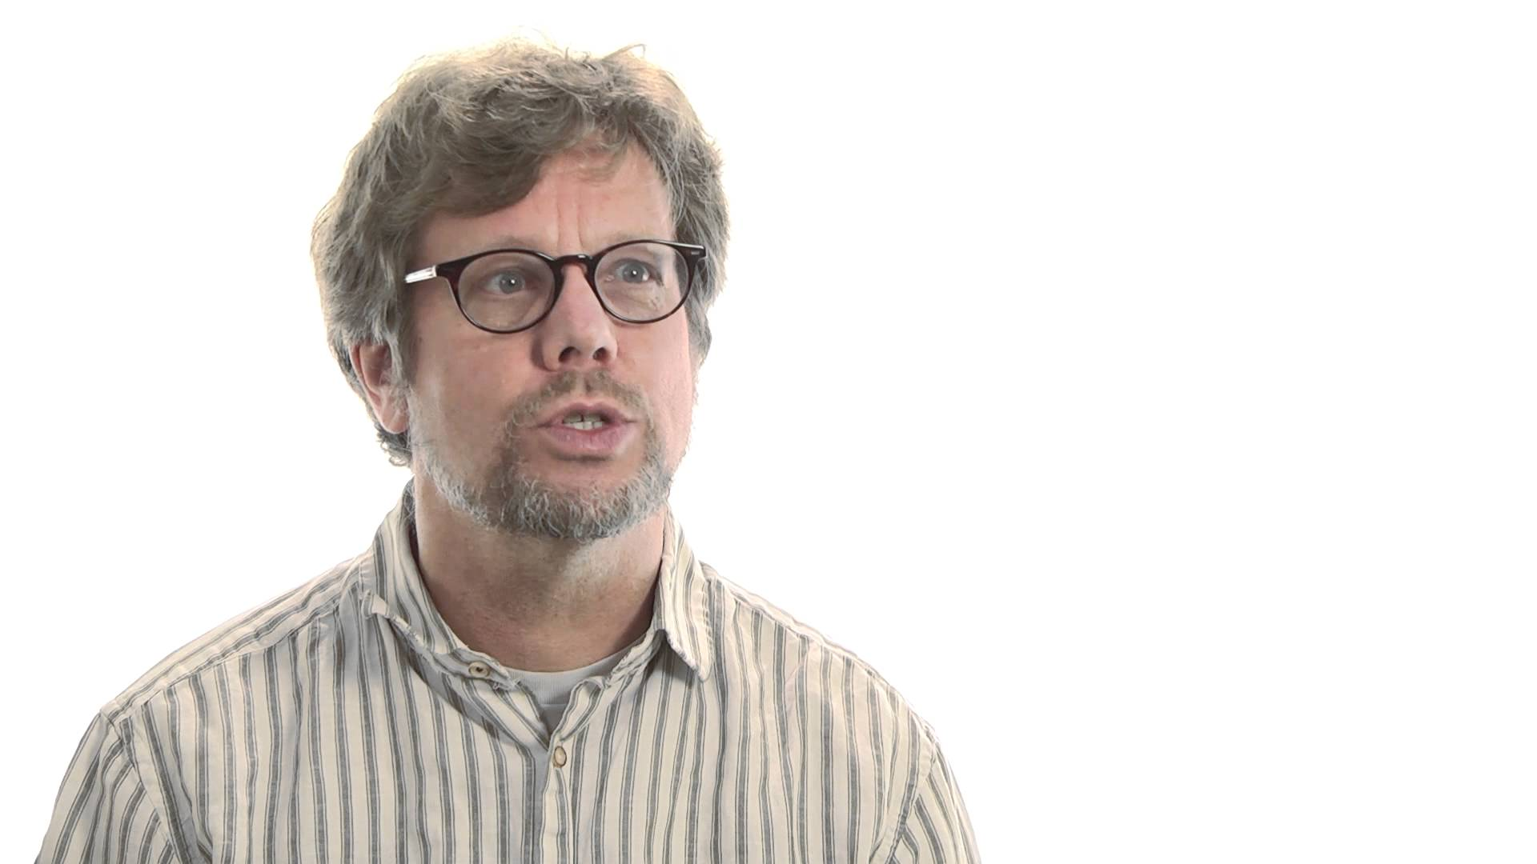
Why was Python created ?
Guido started Python development as a hobby in 1989
But since then it has grown to become one of the most polished languages of the computing world.

Slide 8

How Python got it’s name?
The name Python is inspired from Guido’s favorite Comedy TV show called “Monty Python’s Flying Circus”
Guido wanted a name that was short, unique, and slightly mysterious, so he decided to call the language Python.

Slide 9
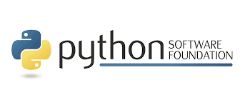
Who manages Python today ?
From version 2.1 onwards , Python is managed by Python Software Foundation situated in Delaware , USA
It is a non-profit organization devoted to the growth and enhancement of Python language
Their website is http://www.python.org

Slide 10
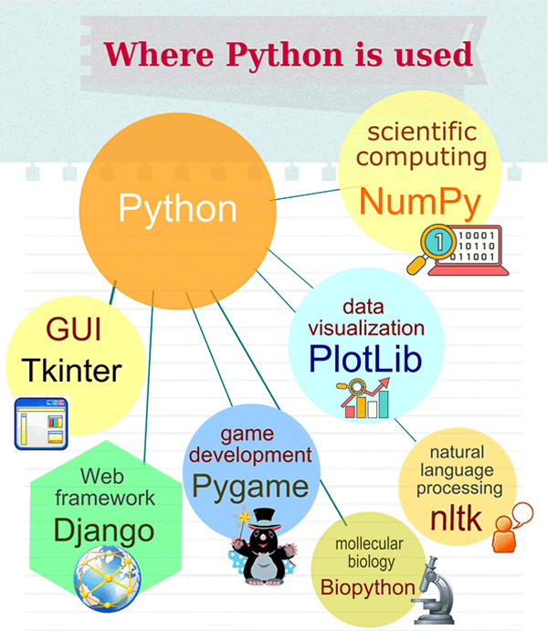
What Python can do ?
GUI Application
Web Application
Data Analysis
AI & ML
Raspberry Pi
Hacking

Slide 11
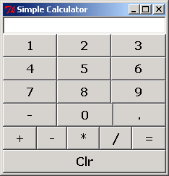
GUI In Python
Python is used for GUI apps all the time.
It has famous libraries like PyQT , Tkinter to build desktop apps.

Slide 12
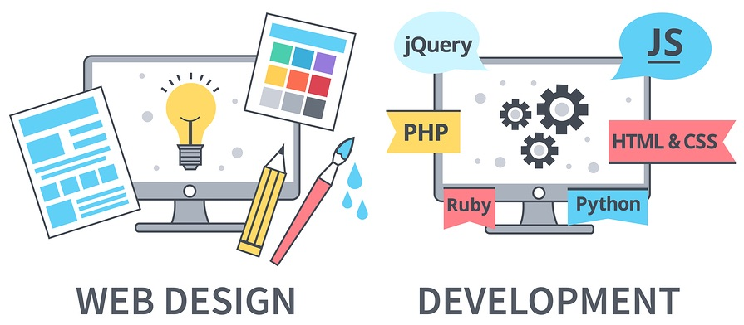
Web Application In Python
We can use Python to create web applications on many levels of complexity

Slide 13
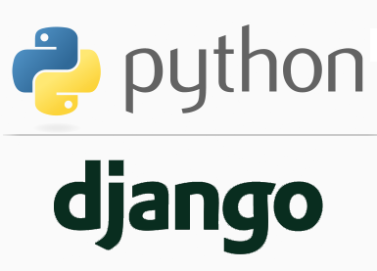
Famous Websites Developed Using Python
There are numerous examples of popular, high-load websites/webapps that have been developed using Python.
Here are some of the most popular of them:
NASA
Instagram
Mozilla
Spotify
Reddit
Dropbox
And above all YouTube

Slide 14
Web Application In Python
There are many excellent Python frameworks like Django, Flask for web application development

Slide 15
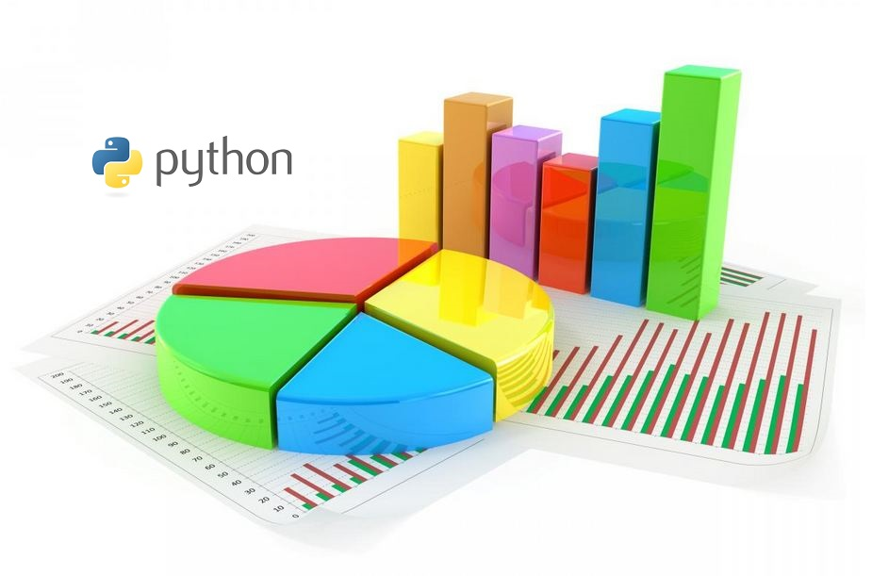
Data Analysis In Python
Data Analysis is about making predictions with data

Slide 16
Some Examples
How do you think Super Market stores decide what products to keep in stock?
What are the items they should club together to make a combo?
How it happens ?
Answer: Data analytics

Slide 17
Some Examples
Have you noticed that every time you log on to Google, Facebook and see ads, they are based on your preferences
How it happens ?
Answer: Data analytics

Slide 18
Data Analysis In Python
Python is the leading language of choice for many data scientists
It has grown in popularity due to it’s excellent libraries like Numpy , Pandas etc

Slide 19
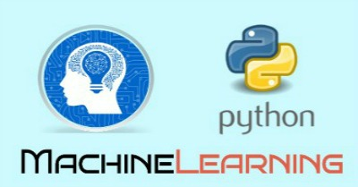
AI & ML In Python
Machine learning is a field of AI (Artificial Intelligence) by using which software applications can learn to increase their accuracy for the expecting outcomes.
It is heavily used in Face recognition , music recommendation , medical data etc
Python has many wonderful libraries to implement ML algos like SciKit-Learn , Tensorflow etc

Slide 20
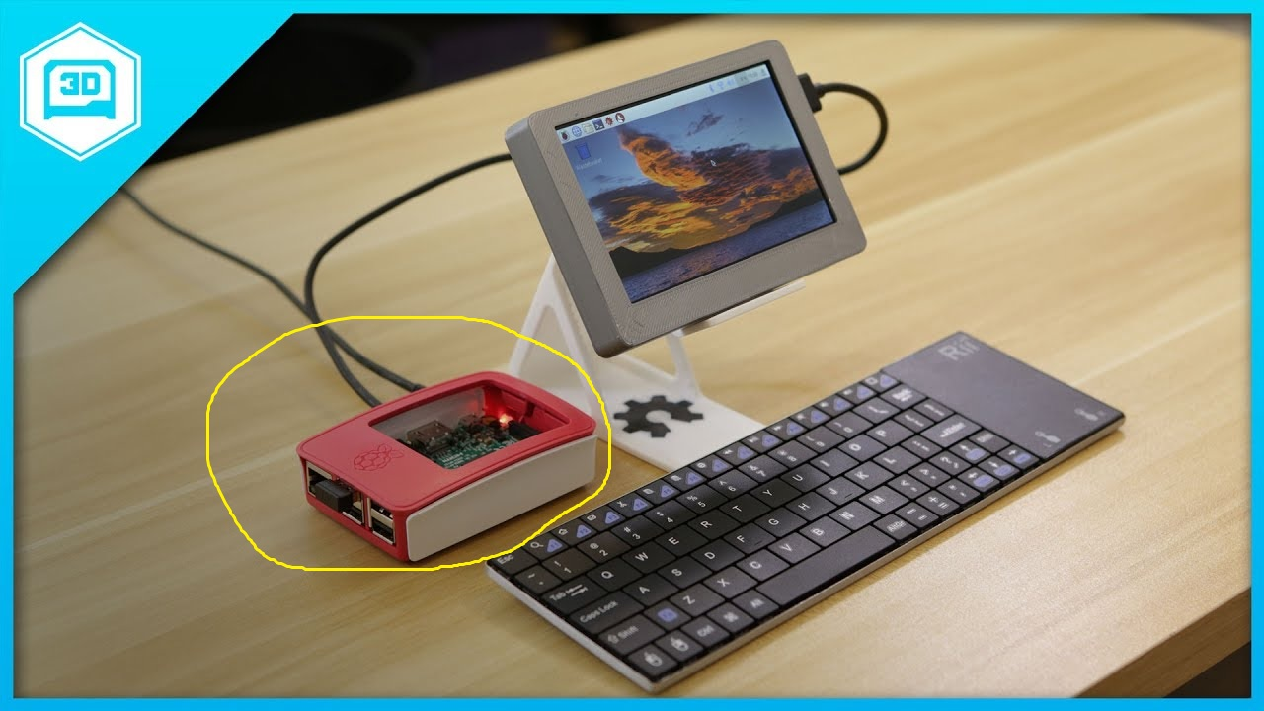
Raspberry Pi In Python
The Raspberry Pi is a low cost, credit-card sized computer that plugs into a computer monitor or TV, and uses a standard keyboard and mouse.
It can do almost everything a normal desktop can do

Slide 21
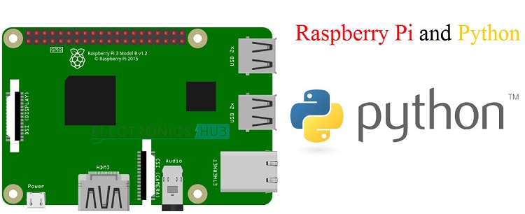
Raspberry Pi In Python
We can build Home Automation System and even robots using Raspberry-Pi
The coding on a Raspberry Pi can be performed using Python

Slide 22
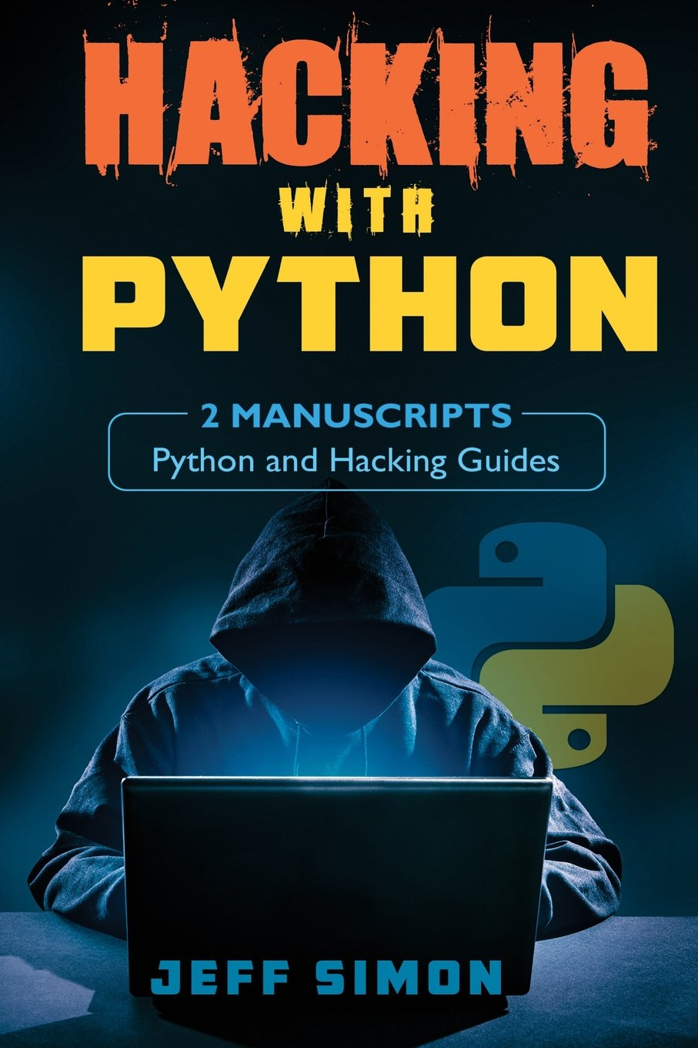
Hacking In Python
Python has gained popularity as preferred language for hacking.
Hackers generally develop small scripts and Python provides amazing performance for small programs

Slide 23
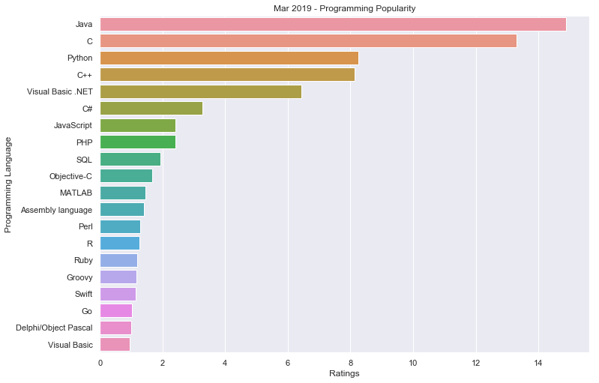
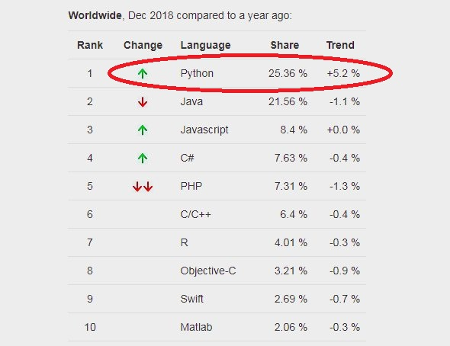
Why should I learn Python ?
3rd most popular programming
Fastest growing language
Opens lots of doors
Big corporate prefer Python
Means , PYTHON IS THE FUTURE

Slide 24
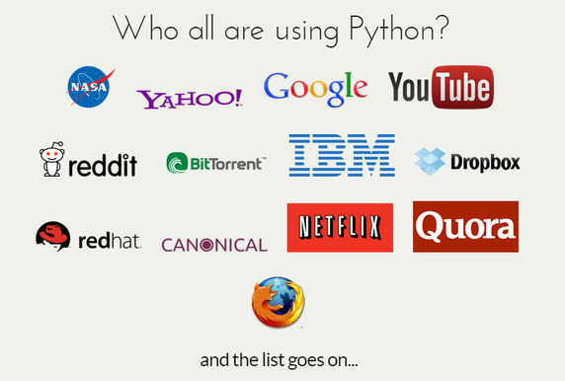
Who uses Python today ?

Slide 25
Features Of Python
Simple
Dynamically Typed
Robust
Supports multiple programming paradigms
Compiled as well as Interpreted
Cross Platform
Extensible
Huge Library

Slide 26
Simple
Python is very simple
As compared to other popular languages like Java and C++, it is easier to code in Python.
Python code is comparatively 3 to 5 times smaller than C/C++/Java code

Slide 27
Print Hello Bhopal!
IN C
#include <stdio.h>
int main(){
printf("Hello Bhopal!");
return 0;
}
IN JAVA
public class HelloWorld{
public static void main( String[] args ) {
System.out.println( "Hello Bhopal!" );
}
}
IN PYTHON
print('Hello Bhopal!')

Slide 28
Add 2 Nos
IN C
#include <stdio.h>
int main(){
int a=10,b=20;
printf(“Sum is %d”,a+b);
return 0;
}
IN JAVA
public class HelloWorld{
public static void main( String[] args ) {
int a=10,b=20;
System.out.println( “Sum is “+(a+b));
}
}
IN PYTHON
a,b=10,20;
print(“Sum is”,a+b)

Slide 29
Swap 2 Nos
IN C
int a=10,b=20,temp;
temp=a;
a=b;
b=temp;
IN JAVA
int a=10,b=20,temp;
temp=a;
a=b;
b=temp;
IN PYTHON
a,b=10,20
a,b=b,a

Slide 30
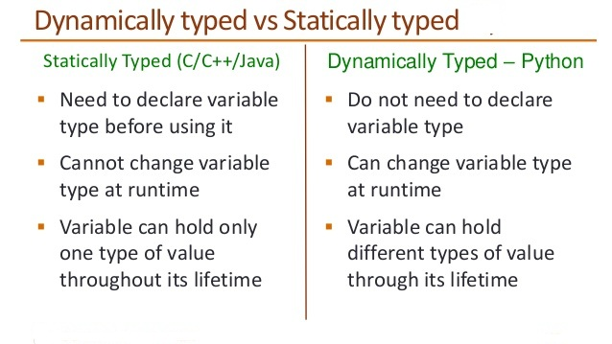
Dynamically Typed

Slide 31

Dynamically Typed
IN C
int a;
a=10;
a=“Bhopal”;
IN Python
a=10
a=“Bhopal”

Slide 32
Robust
Python has very strict rules which every program must
compulsorily follow and if these rules are violated then Python terminates the code by generating “Exception”
To understand python’s robustness , guess the output of the
following /C++ code:
int arr[5];
int i;
for(i=0;i<=9;i++)
{
arr[i]=i+1;
}

Slide 33
Robust
In Python if we write the same code then it will generate Exception terminating the code
Due to this other running programs on the computer do not get affected and the system remains safe and secure

Slide 34
Supports Multiple Programming Paradigms
Python supports both procedure-oriented and object-oriented programming which is one of the key python features.
In procedure-oriented languages, the program is built around procedures or functions which are nothing but reusable pieces of programs.
In object-oriented languages, the program is built around objects which combine data and functionality

Slide 35
Compiled As Well As Interpreted
Python uses both a compiler as well as interpreter for converting our source and running it
However , the compilation part is hidden from the programmer ,so mostly people say it is an interpreted language

Slide 36
Cross Platform
Let’s assume we’ve written a Python code for our Windows machine.
Now, if we want to run it on a Mac, we don’t need to make changes to it for the same.
In other words, we can take one code and run it on any machine, there is no need to write different code for different machines.
This makes Python a cross platform language

Slide 37
Extensible
Python allows us to call C/C++/Java code from a Python code and thus we say it is an extensible language
We generally use this feature when we need a critical piece of code to run very fast .
So we can code that part of our program in C or C++ and then use it from our Python program.

Slide 38
Huge Library
The Python Standard Library is huge indeed.
It can help you do various things like Database Programming , E-mailing ,GUI Programming etc

